Slide 1


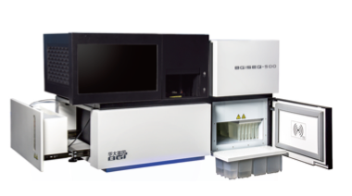
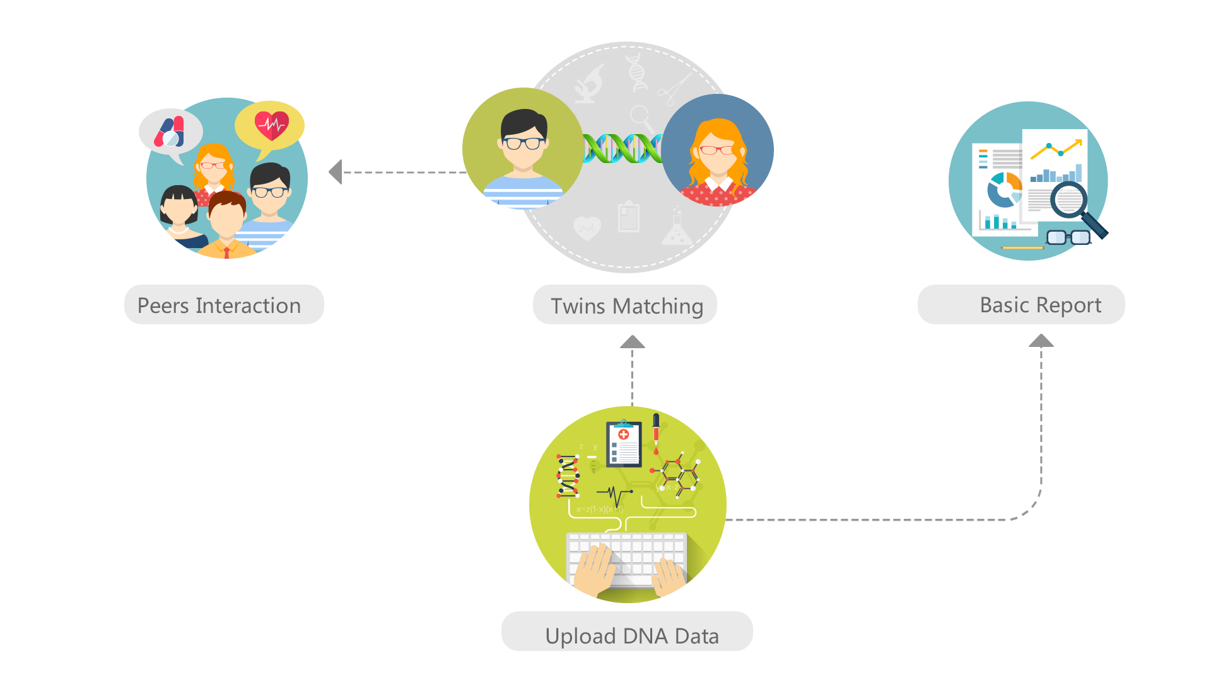



GeneTank GWAS AI Model Sharing Platform
Blockchain On-chain DB
ModelRepo Off-chain DB
Transaction0
Transaction1
Transaction2
... ...
Hash signature
Transaction1
GenetankAI smart contract
... ...
Hash signature
TransactionM
... ...
Hash signature
Intel IAS
GeneTank
Token (GTT)
Contract
“ICO”
AI Model packages
Genetank
Service Provider
Data
Recruit
Contract
AI Model
Contract
Phase-II
Phase-I
Recruit data for model training
Register with
certificates
AI Model packages
AI Model Enclave
Data Owner with BGI-seq 500
AI Model Trainer
AI Model Runner
AI Model User

Slide 2

GeneTank GWAS AI Model Sharing Platform
Blockchain
Data register
Data sharing
Contract
APP
Transaction0
Transaction1
Transaction2
... ...
Hash signature
Transaction1
GenetankAI smart contract
... ...
Hash signature
TransactionM
... ...
Hash signature
Data/Service
Provider
Token Contract
On-chain DB
Data searching
Off-chain DB
APP
Public Repositories
Data service requesting
Data/Service
User
Trusted Execution Environments (TEEs)

Slide 3

Development Framework
GeneTank Website
List of models and links
TestRPC Blockchain
http://blockchain.genetank.ai:8545
Transaction1
Contract1
Contract2
... ...
Hash signature
TransactionN
Contracta
Contractb
... ...
Hash signature
TransactionM
Contractx
Contracty
... ...
Hash signature
Runner
Wallet
AI Model
Contract
GeneTank
Token (GTT)
Contract
Anne
User
Wallet
Trainer
Wallet
Sandeep
On-Chain
Off-Chain
Node Web3 js
Sandeep
Browser
Larry
ModelRepo
Web Server
Meteor framework
Browser
AI Model
Runner
Runner web page
javascript
Server javascript
User web page
javascript
End User
Lauren
SGX on a desktop PC
Download and install
AI Model in TEE Enclave
AI Model Training
Shifa
AI Model Server
Browser
Lauren
Dianbo
Trainer web page
javascript
AI Model Trainer

Slide 4
Phase-II Development Framework
Ropsten testnet Blockchain
PayPal
Intel IAS
Block 0
Transaction1
Transaction2
... ...
Hash signature
Block N
Transaction a
Transaction b
...
Hash signature
Block M
Transaction x
Transaction y
... ...
Hash
signature
Genetank
Wallet
GeneTank
Token (GTT)
Contract
GenetankAI
Contract V2
Linux / Meteor
Genetank Server:
ModelRepo
Attestation service
E-com platform
Sandeep
Anne
Shifa, Lauren, Sandeep
Ethereum
Devp2p
communication
network
Ethereum
Wallet
Enclaves: (Linux)
Data validation
AI training
Query services
Meteor
Backend
Browser
Frontend
Dianbo
Genetank Customers
Donor
Trainer
Runner
User
Enclaves
Dapp
Win
Mac
Android
Ios
GTT wallet
User management
Data management
Data preprocess
Data search
Enclave
Meteor
Backend
Anne,
Sandeep,
Larry,
Dianbo, Shifa
Enclave
Shifa
Enclave management

Slide 5
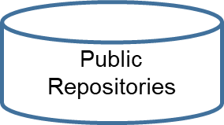


Phase-II Development Framework
Data sharing
Contract
Blockchain
WWW
Transaction1
Contract1
... ...
Hash signature
TransactionN
Contractn
... ...
Hash signature
TransactionM
Contractm
... ...
Hash signature
Token Contract
Trusted Execution Environment
Blockchain
Wallet
Software
CPU private key
P2P messaging system
Distributed
App (Dapp)
BUS
All Participants
Protected memory image
Private Data Storage
APP

Slide 6
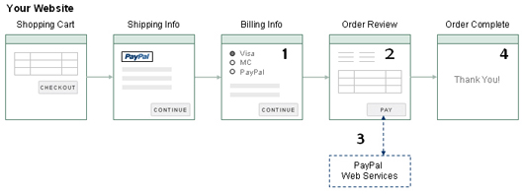
Dapp GTT Wallet buy GTT
3.1
Genetank e-com server
3.2 transfer GTT from Genetank account to buyer’s account
GTT smart contract
Dapp Sell GTT
Number of GTT to sell
1
Send Approve to GTT contract
4
Complete
2
Genetank e-com server
3.1
PayPal Web Services
3.2 transfer GTT from seller’s account to Genetank’s account
Transfer from GTT contract

Slide 7
Enclave Application
Enclave Application
Enclave1..N-1
EnclaveN..M-1
R Scripts
Data management
R Scripts
Data management
VM
VM
Virtual Memory
Virtual Memory
Encrypted large shared memory in untrusted space
Encrypted large shared memory in untrusted space
Encrypted shared memory extension on disk

Slide 8
Diagram of Blockchain Modules
GenetankAI Smart Contract
Legend:
Enclave Packages
Model Params
Enclave Instances
Access Codes
Sharing Functions
Functional module
Auditor Functions
Trainer Functions
Runner Functions
Querying Functions
Data
Auditor Wallet
Trainer Wallet
Runner Wallet
User Wallet
Nodejs Web3 interface
Auditor Frontend
Trainer Frontend
Runner Frontend
Querying Frontend
SSL
Enclave Untrusted
Customer DAPP
Model Parameters
Genetic Data
Enclave Trusted
Enclave Packages
Model Params
Enclave Instances
GeneTank Attestation Service (GTAS)
SGX enclave
ModelRepo

Slide 9
SGX Enclave Module Diagram
Legend:
SSL
Functional module
Enclave Control
Blockchain Op
AI Model management
Data
Remote Attestation
Attestation
AI Model
Rest server
Rest API
Key Management
SGX enclave

Slide 10
Smart Contract Data Structure Hierarchy
key: Auditor address
key: Trainer address
key: Hash of enclave (MRENCLAVE)
Auditing Record mapping
Enclave mapping
Enclave Package mapping
key: Runner address
Enclave Runner mapping
key: access code
key: Hash of model parameters
Access codes mapping
Model Param
mapping

Slide 11

The Security of SGX
Enclave image file
Load
CPU: Calculates the measurement of the newly loaded enclave and verify with the measurement provided by the developer.
Enclave Certificate
SGX Enclave Developer
CPU private key*
SGX Pubkey
SGX Prvkey
SGX enabled CPU
CPU signed enclave memory measurement and enclave public key
SGX enclave signed by the developer and audited by 3rd parties
*The CPU private key is generated while production. Nobody knows it.
SGX Signing key pair
IAS : Intel Attestation Service, verifies the CPU signed enclave certificate with CPU EPID public key
Attester: Save the attestation report to the blockchain
. Get the attestation report from the blockchain, exam the auditing and attesting records
. Verify the enclave with its public key (certified by attestation)
SGX Enclave attester
SGX Enclave verifier (Who needs to send private data to the enclave)
* The attestation verify: Is the CPU the Intel secure CPU? Is the enclave the original one from the developer.

Slide 12
GeneTank Token (GTT)
Blockchain
GeneTank
Token (GTT)
Contract
“ICO”
Transaction1
Contract1
Contract2
... ...
Hash signature
Transaction1
Contract1
Contract2
... ...
Hash signature
TransactionN
Contracta
Contractb
... ...
Hash signature
TransactionM
Contractx
Contracty
... ...
Hash signature
GeneTank Token (GTT) is coin-like token which is design for payment of GeneTank AI model and other data usages.
GTT is implemented with a smart contract
GTT is mineable

Slide 13
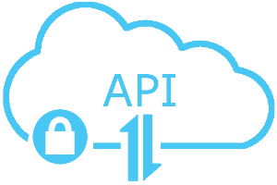
New Enclave Version Releasing Flow
Blockchain
Transaction1
Contract1
Contract2
... ...
Hash signature
Transaction1
Contract1
Contract2
... ...
Hash signature
AI Model Trainer
❺
Register a new enclave package
AI Model
Contract
Auditor
❸
❶
ModelRepo
❷
Pubkey
❹
ModelRepo, or IPFS/Swarm, etc. are used for off-chain data
Prvkey
Enclave Package
SGX Signing key pair

Slide 14
New Enclave Instance Registering Flow
Blockchain
Transaction1
Contract1
Contract2
... ...
Hash signature
Transaction1
Contract1
Contract2
... ...
Hash signature
TransactionN
Contracta
Contractb
... ...
Hash signature
AI Model
Contract
❹
❸
ModelRepo
❷
❶
AI Model Trainer
Enclave packages
Enclave Instance
AI Model Runner

Slide 15
AI Model Querying Flow
Blockchain
Transaction1
Contract1
Contract2
... ...
Hash signature
TransactionN
Contracta
Contractb
... ...
Hash signature
TransactionM
Contractx
Contracty
... ...
Hash signature
❸
AI Model
Contract
❺
❹
ModelRepo
❷
AI Model Trainer
❶
AI Model Runner
End User

Slide 16
SGX APP and Enclave Design
Enclave feature requirements
Remote attestation
by model trainer, users
HE key management
key generation
sending public key
private key sealing and cloning
HE decryption and encryption
AI Model training/running
Enclave modules
Remote attestation
Key management
HE crypto
AI model
APP feature requirements
Enclave management (ID, etc.)
Enclave communication support
Query transaction management
APP modules
Enclave management
Communication module
Query management

